Slide 1
Python MySQL Connectivity
Dr. Mohammad almalag

Slide 2
Contents
MySQL Python Connector
How to download MySQL Python Connector
Create connection
Insert, delete, update
Keyring package

Slide 3
MySQL Python Connector
MySQL Connector/Python enables Python programs to access MySQL databases, using an API that is compliant with the Python Database API Specification
Almost all features provided by MySQL Server up to and including MySQL Server version 8.0.
All MySQL extensions to standard SQL syntax.
Protocol compression, which enables compressing the data stream between the client and server.
Connections using TCP/IP sockets and on Unix using Unix sockets.
Self-contained driver. Connector/Python does not require the MySQL client library or any Python modules outside the standard library.

Slide 4
How to download MySQL Python Connector
There are several ways to download MySQL Python Connector.
Command window:
Open Command window
type pip install mysql-connector-python
PyCharm:
File->Settings->Project->Project Interpreter
then select your Python interpreter and click install button (the little green plus sign)
input " mysql-connector-python " and click the button "install package"

Slide 5
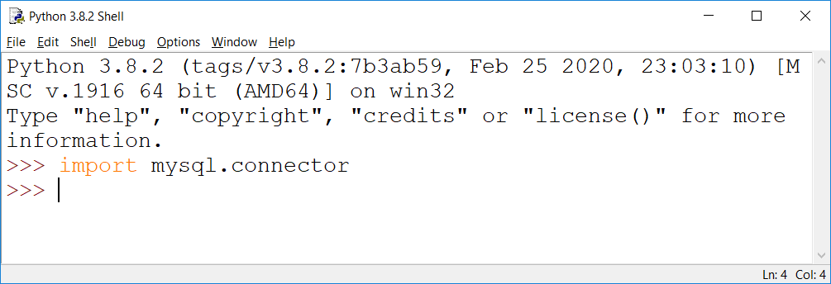
Now, to check whether mysql-connector is installed/working properly
Open Python IDLE
Type import mysql.connector
If no error occurs, it means mysql-connector is working properly

Slide 6
Create connection
Import mysql.connector module
Create the connection object.
Create the cursor object
Execute the query

Slide 7
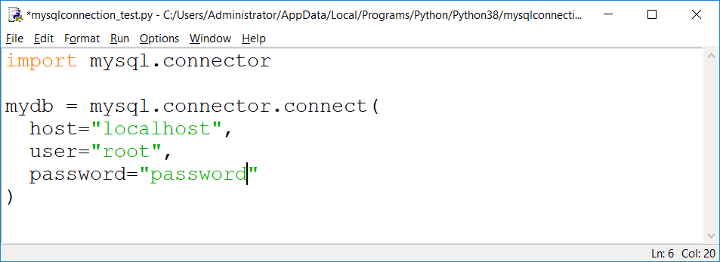
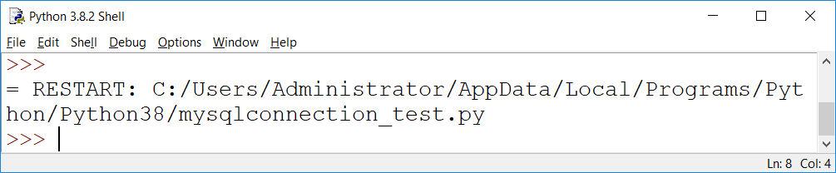
Creating the connection : connect () method
Pass the database details like HostName, username, and the database password in the method call. The method returns the connection object.
Syntax :
ConnObject = mysql.connector.connect
(host = <hostname>, user = <username> , passwd = <password> )

Slide 8
Cursor in Python
Cursors are created by the connection.cursor() method : they are bound to the connection for the entire lifetime of the program and all the commands are executed in the context of the database session wrapped by the connection.
<cur_obj> = conn.cursor()
Note : We need cursor to execute our MySQL Queries

Slide 9
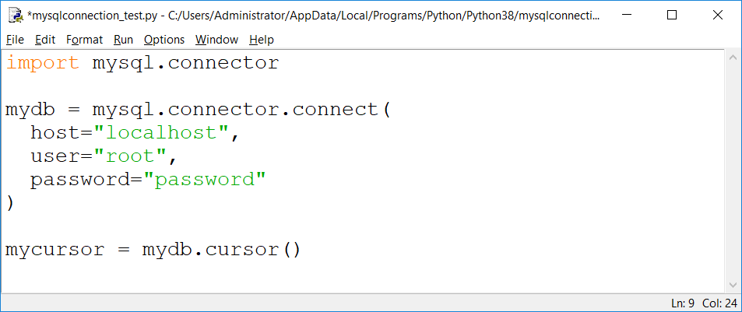
Cursor in Python

Slide 10
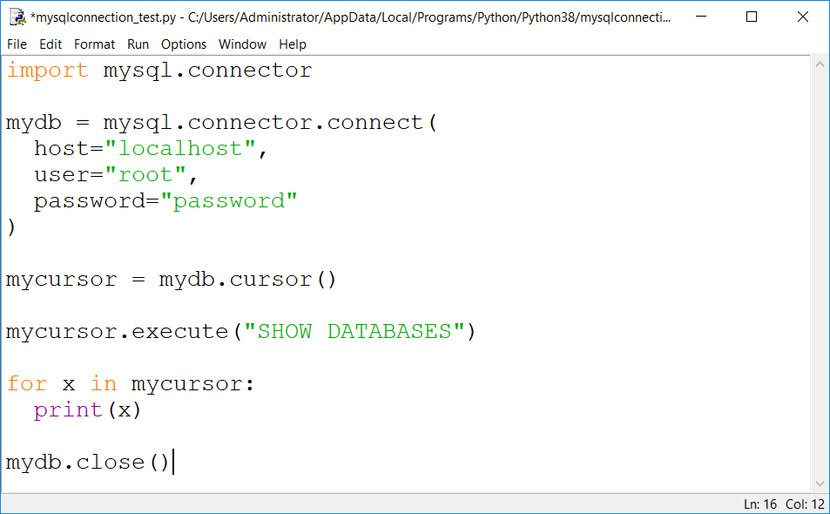
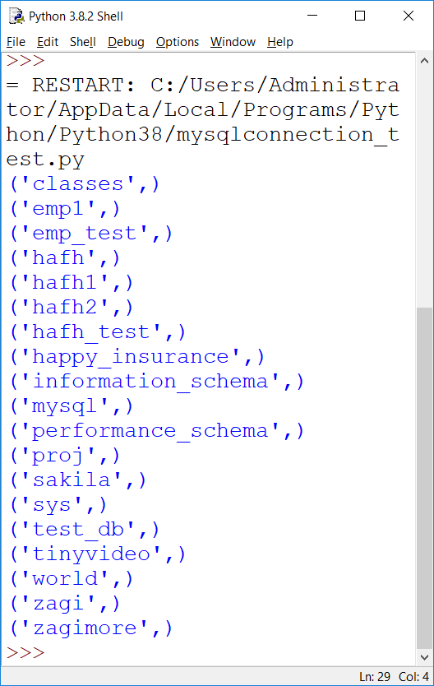
Execute the query
With the help of execute(), we can run any MySQL query.
Showing list of databases

Slide 11
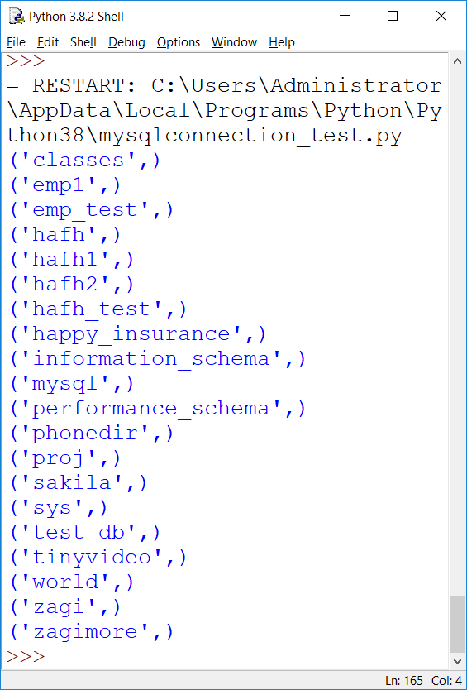
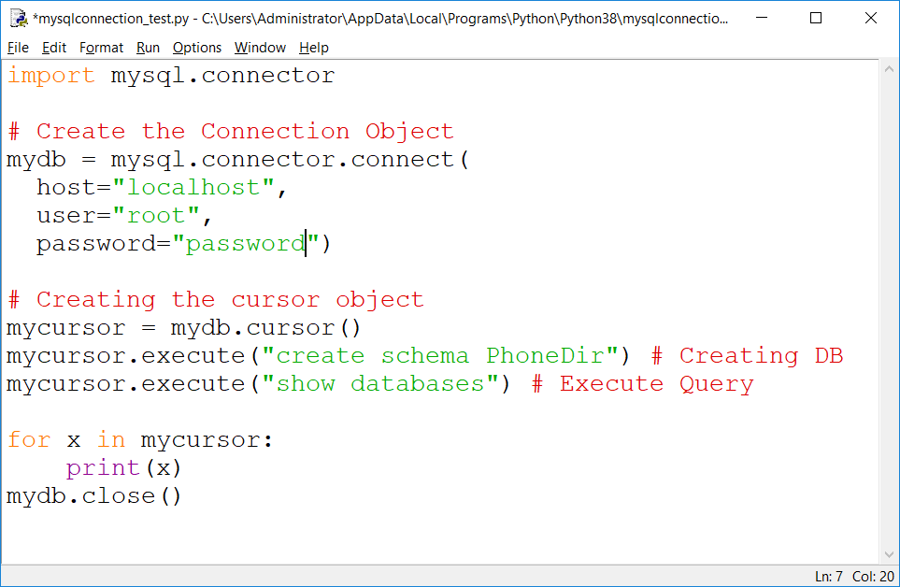
We can also create our database through python
Creating Database
output
See a newdatabase phonedir is created

Slide 12
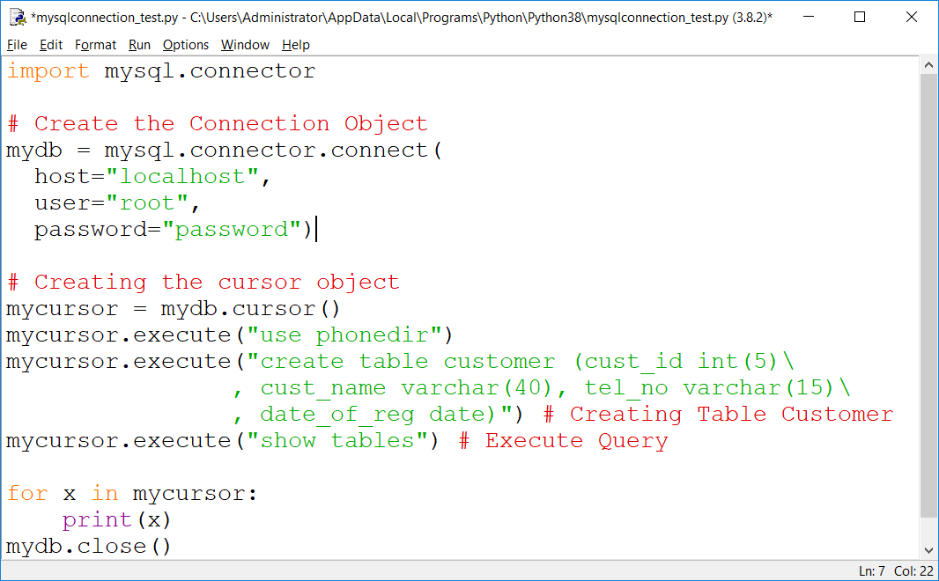
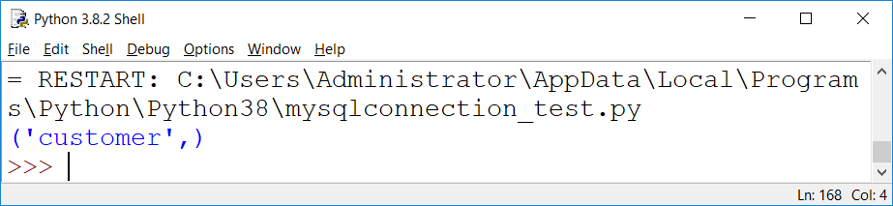
Now , lets create a table ‘customer’
Creating table
Displaying list of tables
OUTPUT

Slide 13
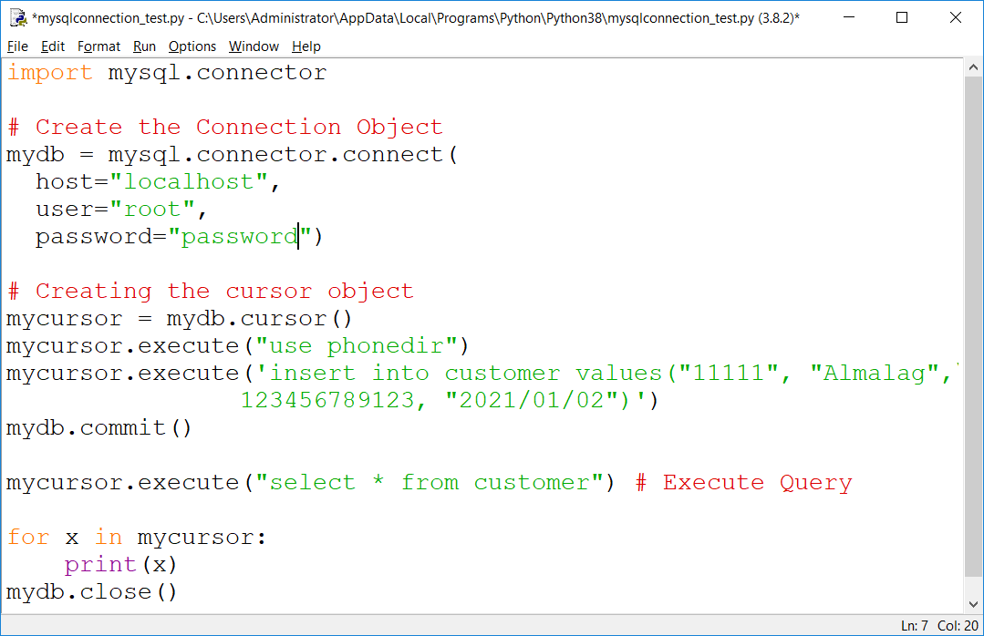
Inserting data into table customer
Inserting a record
It is required to make the changes, otherwise no changes are made to the table.

Slide 14
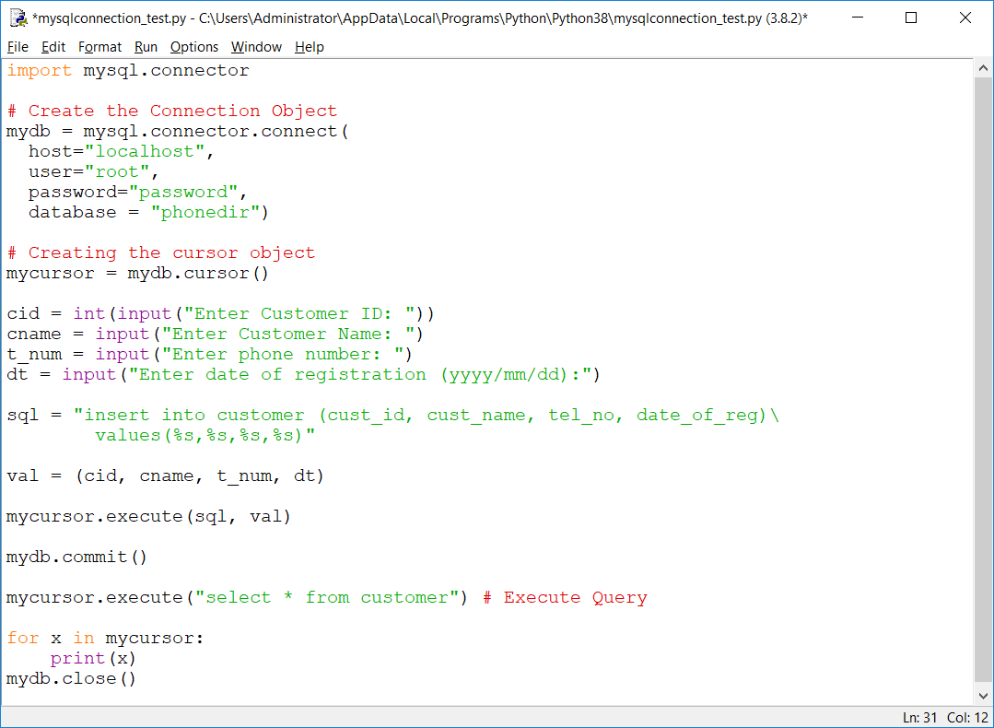
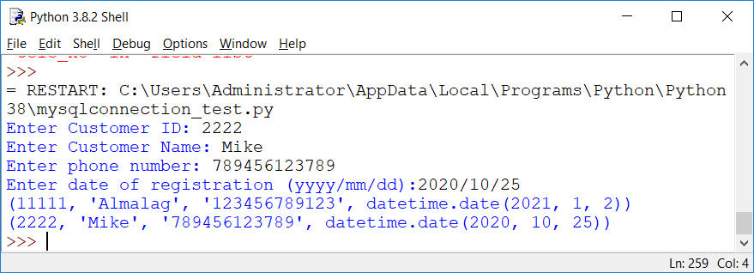
Inserting records by taking its input by user
OUTPUT
With INSERT INTO statement, we can mention the format specifier (%s) in place of values.

Slide 15
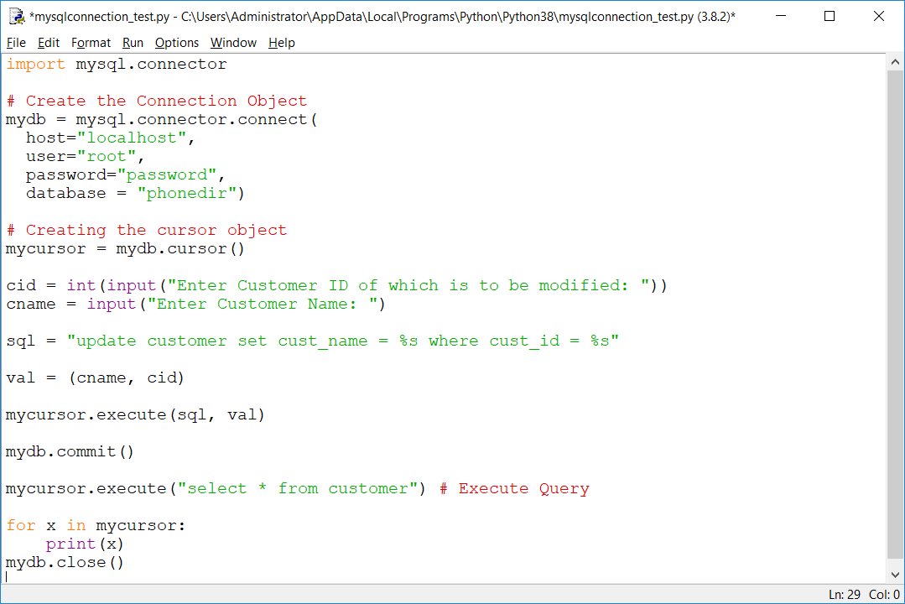
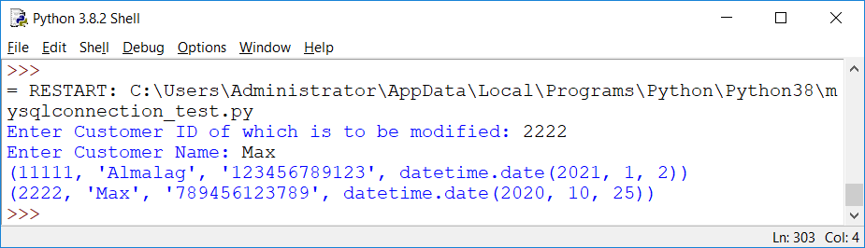
Update
Name of 2222 customer is changed to Max

Slide 16
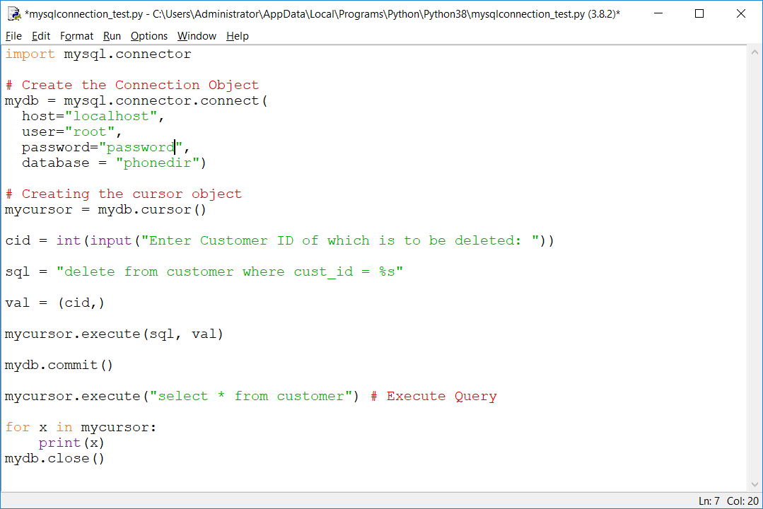
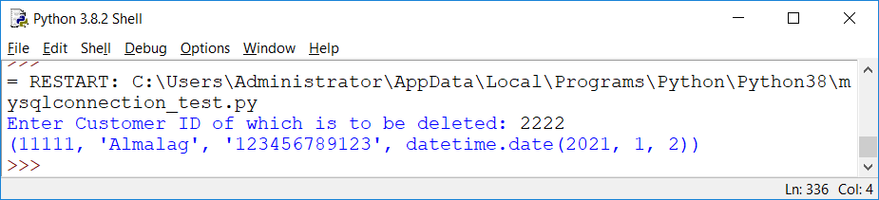
Deleting record
Record with cust_id 2222 is deleted now

Slide 17
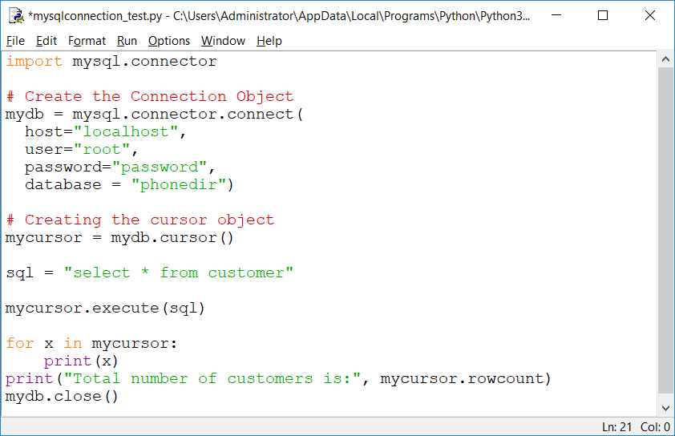
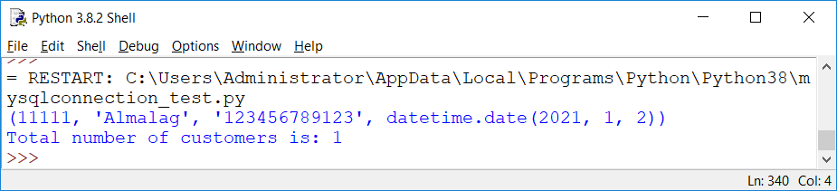
Cursor.rowcount
It will display no. of records fetched after running
You can Query.run this command after executing any query.
Printing no. of records

Slide 18
Other methods
cursor.fetchall() fetches all the rows of a query result. It returns all the rows as a list of tuples. An empty list is returned if there is no record to fetch.
cursor.fetchmany(size) returns the number of rows specified by size argument. When called repeatedly this method fetches the next set of rows of a query result and returns a list of tuples. If no more rows are available, it returns an empty list.
cursor.fetchone() method returns a single record or None if no more rows are available.

Slide 19
Error Handling
For Error Handling Two more module we need to import, are:
from mysql.connector import Error
from mysql.connector import errorcode
MySQL connector Error object is used to show us an error when we failed to connect Databases or if any other database error occurred while working with the database.
Error expecting code must be written in try………..except block

Slide 20
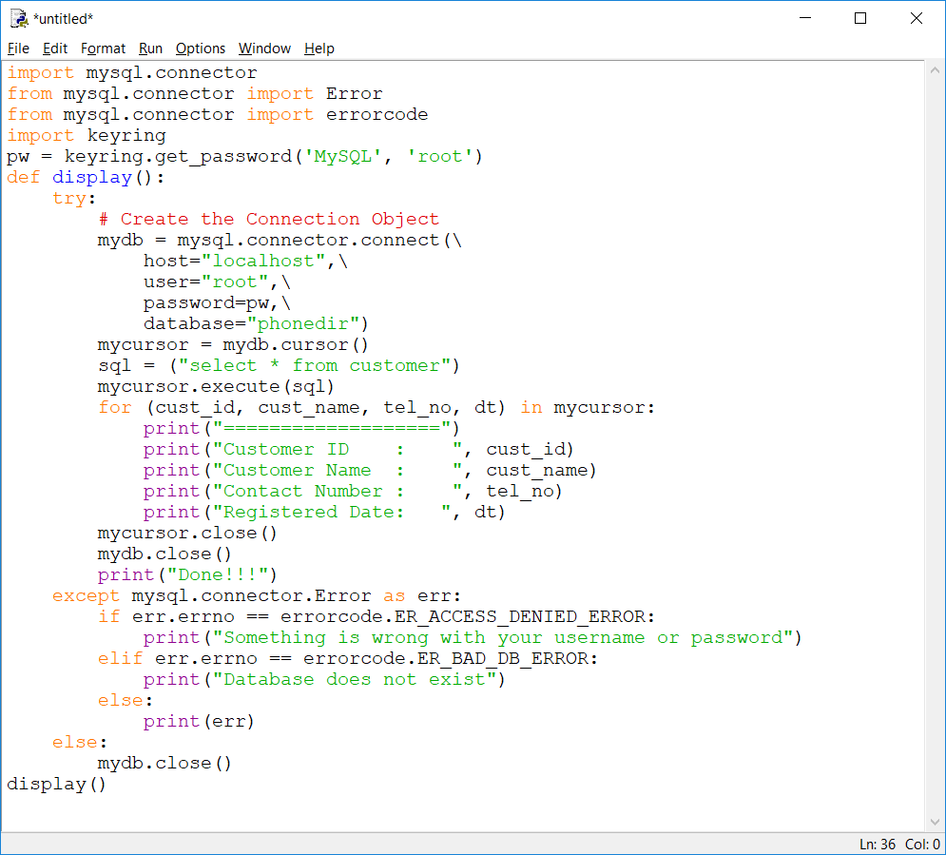
Error Handling code while displaying records

Slide 21
Output
===================
Customer ID : 11111
Customer Name : Almalag
Contact Number : 123456789123
Registered Date: 2021-01-02
Done!!!

Slide 22
How to hide a password in a Python script with keyring
keyring is an easy-to-use package that works by allowing you to store a password in your operating system’s credential store.
To get started, just use pip to install:
pip install keyring
Next, let’s import keyring.
import keyring

Slide 23
set_password method
This method has three parameters:
Servicename. This is the name you choose for whatever service. For example, MySQL
Username that is associated with the service. In this case, MySQL username.
password that is associated with the service.
Example:
keyring.set_password(“MySQL", "username", "password")

Slide 24
get_password method
To retrieve the password, we just need to use the get_password method with the “servicename” value and username.
For Example:
keyring.get_password(“MySQL", "username")

Slide 25
References
https://www.w3schools.com/python/python_mysql_getstarted.asp
https://alexwlchan.net/2016/11/you-should-use-keyring/

